Slide 1

Geometry
Unit 7, Lesson H2 Law of Cosines Volume 1, pg. 433

Slide 2


Benchmark
MA.912.T.1.3
Apply the Law of Sines and the Law of Cosines to solve mathematical and real-world problems involving triangles.
volume 1, pg. 433

Slide 3
Integrated Mathematical Thinking and Reasoning Standards
MA.K12.MTR.1.1 Actively participate in effortful learning both individually and collectively.
MA.K12.MTR.4.1 Engage in discussions that reflect on the mathematical thinking of self and others.
MA.K12.MTR.5.1 Use patterns and structure to help understand and connect mathematical concepts.
volume 1, pg. 433

Slide 4

Learning Target
I can solve mathematical and real-world problems that involve triangles using the Law of Cosines.
volume 1, pg. 433

Slide 5

Warm-Up
volume 1, pg. 434

Slide 6
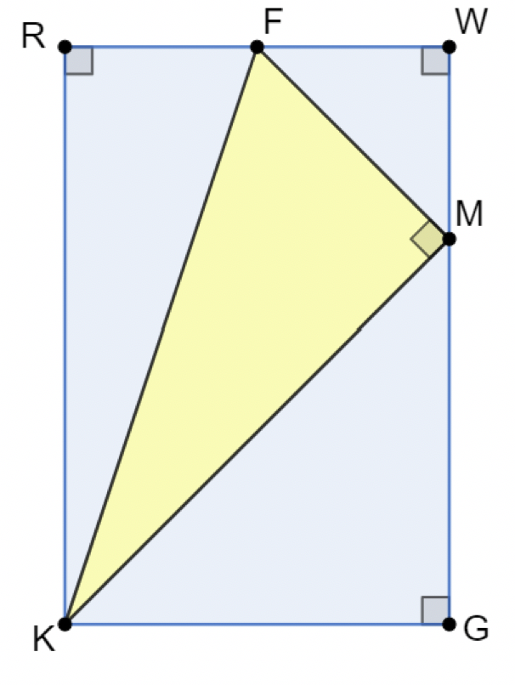
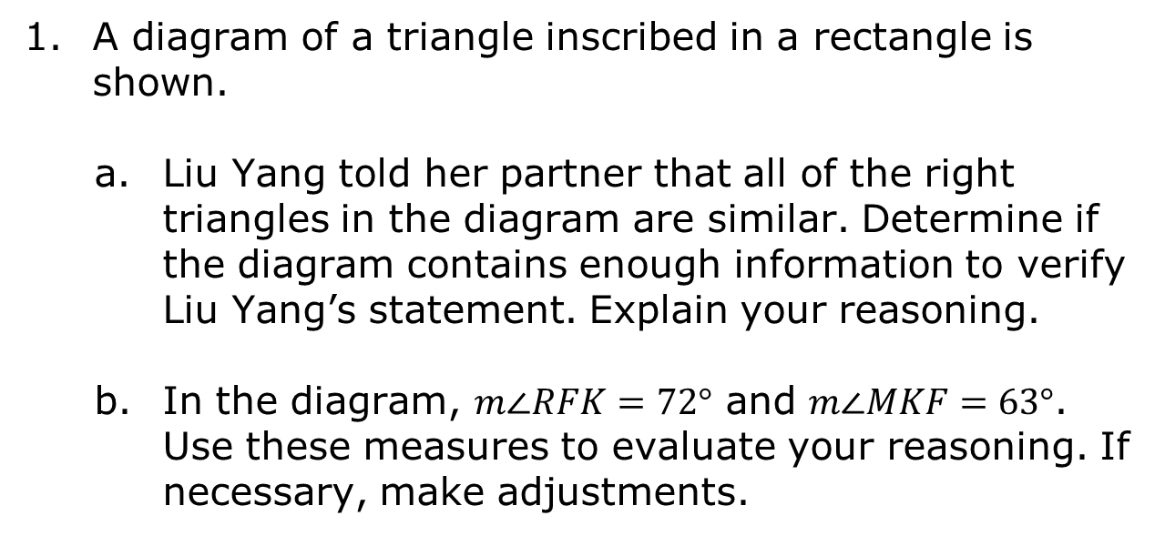
7.H2.1 Warm-Up: Reasoning with Triangles
A diagram of a triangle inscribed in a rectangle is shown.
Liu Yang told her partner that all of the right triangles in the diagram are similar. Determine if the diagram contains enough information to verify Liu Yang’s statement. Explain your reasoning.
In the diagram, $m∠RFK=72°$ and $m∠MKF=63°$. Use these measures to evaluate your reasoning. If necessary, make adjustments.
volume 1, pg. 434

Slide 7

Collaboration
volume 1, pg. 434

Slide 8

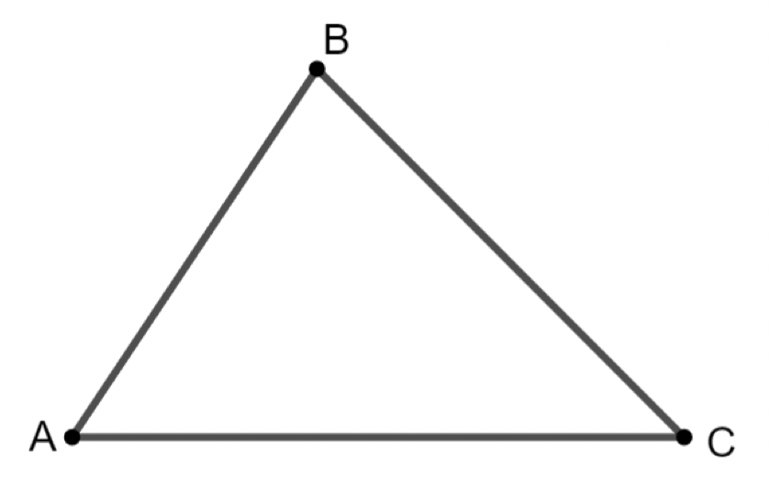

7.H2.2 Collaboration: Deriving the Law of Cosines
A triangle is shown below.
Use $∆ABC$ to complete the following.
Sketch an altitude from vertex $C$.
Label the altitude $h$, and label the point on $\overline{AB}$ as $D.$
Label each line segment. $AC=b, AD=x, CB=a, DB=c−x, AB=c$
volume 1, pg. 434

Slide 9
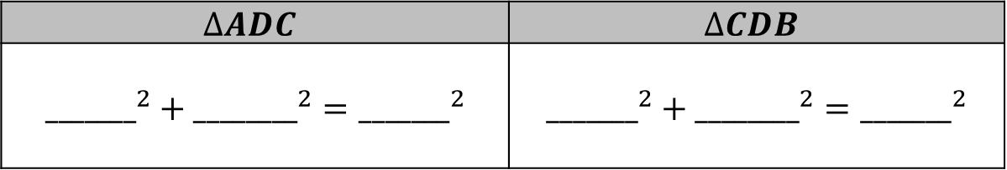
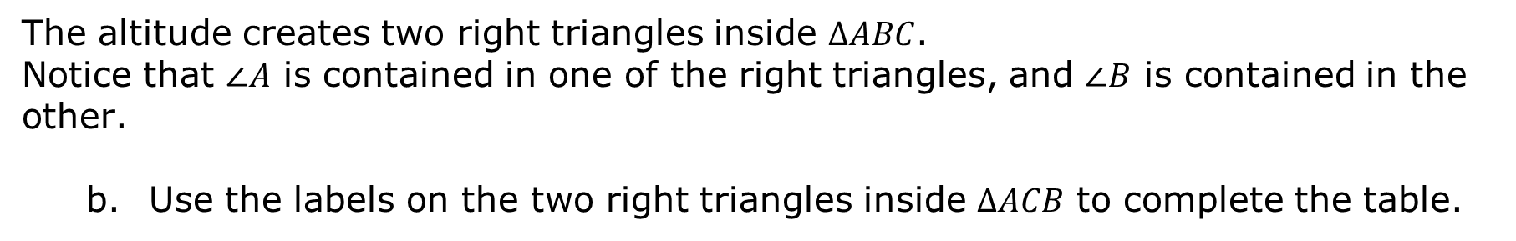
The altitude creates two right triangles inside $ΔABC$.
Notice that $∠A$ is contained in one of the right triangles, and $∠B$ is contained in the other.
Use the labels on the two right triangles inside $ΔACB$ to complete the table.
$$∆ADC$$ | $$∆CDB$$
$${_______}^{2}+{________}^{2}={_______}^{2}$$ | $${_______}^{2}+{________}^{2}={_______}^{2}$$
volume 1, pg. 434

Slide 10
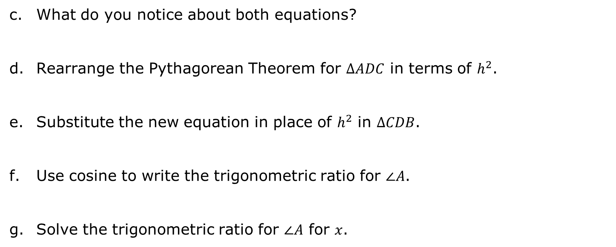
What do you notice about both equations?
Rearrange the Pythagorean Theorem for $ΔADC$ in terms of $h^{2}$.
Substitute the new equation in place of $h^{2}$ in $ΔCDB$.
Use cosine to write the trigonometric ratio for $∠A$.
Solve the trigonometric ratio for $∠A$ for $x$.
volume 1, pg. 435

Slide 11
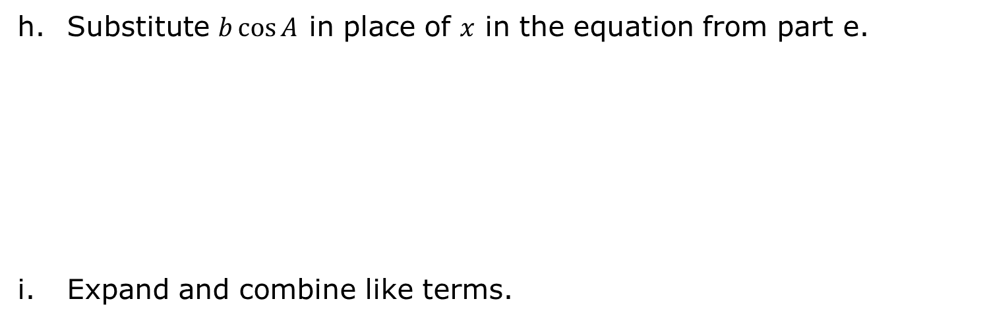
Substitute $b\cos{A}$ in place of $x$ in the equation from part e.
Expand and combine like terms.
volume 1, pg. 435

Slide 12

Guided Instruction
volume 1, pg. 436

Slide 13

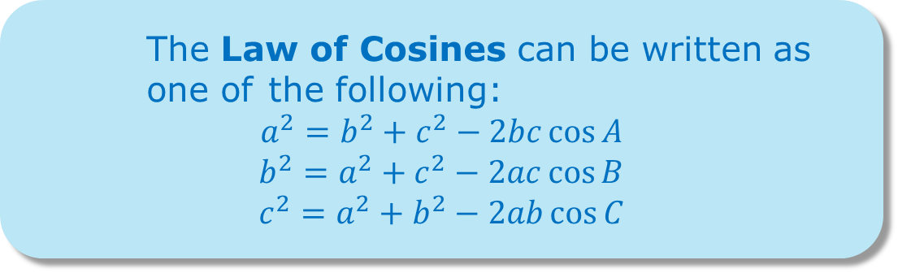
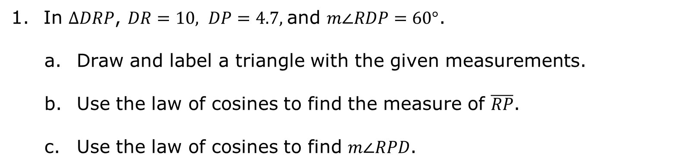
7.H2.3 Guided Instruction: Law of Cosines
The Law of Cosines can be written as one of the following:
$$a^{2}=b^{2}+c^{2}−2bc\cos{A}$$
$$b^{2}=a^{2}+c^{2}−2ac\cos{B}$$
$$c^{2}=a^{2}+b^{2}−2ab\cos{C}$$
In $∆DRP$, $DR=10, DP=4.7,$and $m∠RDP=60°$.
Draw and label a triangle with the given measurements.
Use the law of cosines to find the measure of $\overline{RP}$.
Use the law of cosines to find $m∠RPD$.
volume 1, pg. 436

Slide 14
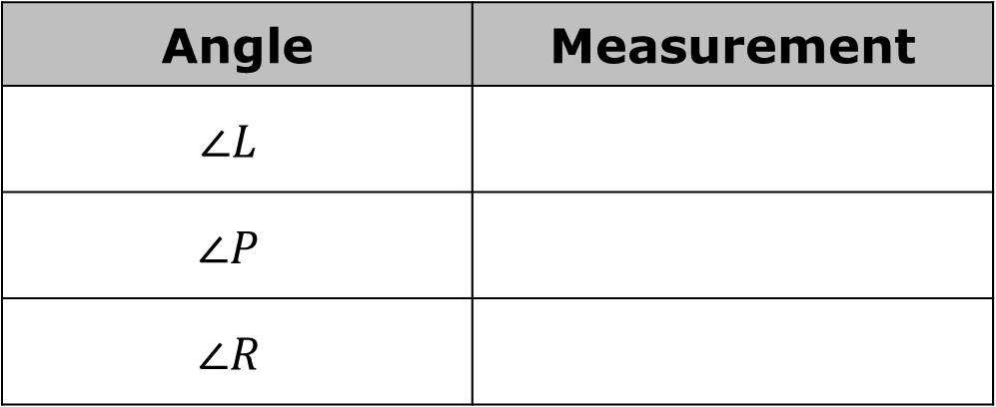
The measurements of the sides of $∆RLP$ are $RL=4.5, PL=7.2$, and $RP=6.7$. Determine the measures of the angles of $∆RLP$.
Angle | Measurement
$$∠L$$
$$∠P$$
$$∠R$$
volume 1, pg. 436

Slide 15

Guided Practice
volume 1, pg. 437

Slide 16

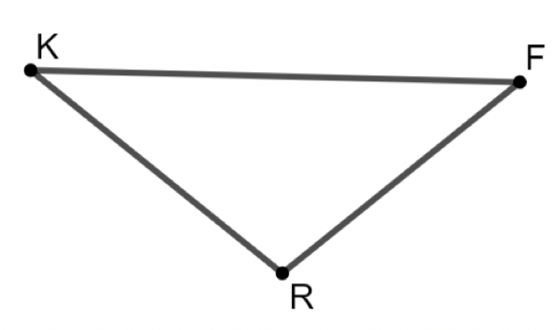
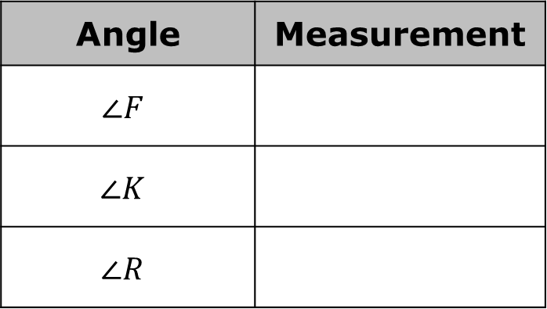
7.H2.4 Guided Practice: Law of Cosines
$∆KFR$ is shown. $KF=15, FR=9,$ and $KR=10$. Find the missing angles.
Angle | Measurement
$$∠F$$
$$∠K$$
$$∠R$$
volume 1, pg. 437

Slide 17
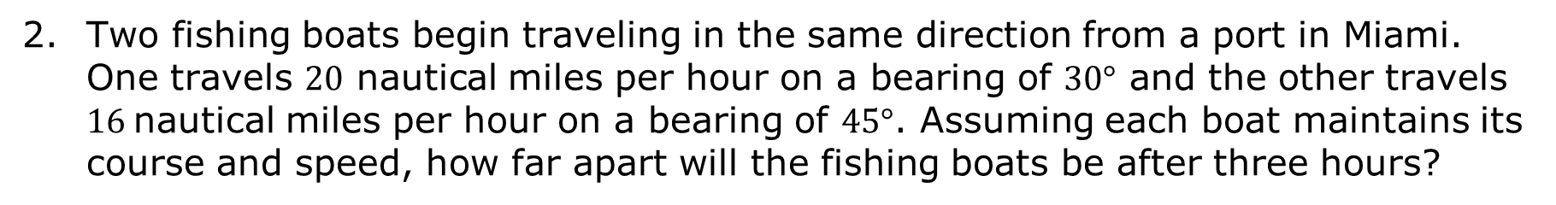
Two fishing boats begin traveling in the same direction from a port in Miami. One travels $20$ nautical miles per hour on a bearing of $30°$ and the other travels $16$nautical miles per hour on a bearing of $45°$. Assuming each boat maintains its course and speed, how far apart will the fishing boats be after three hours?
volume 1, pg. 437

Slide 18

Your Turn
volume 1, pg. 438

Slide 19
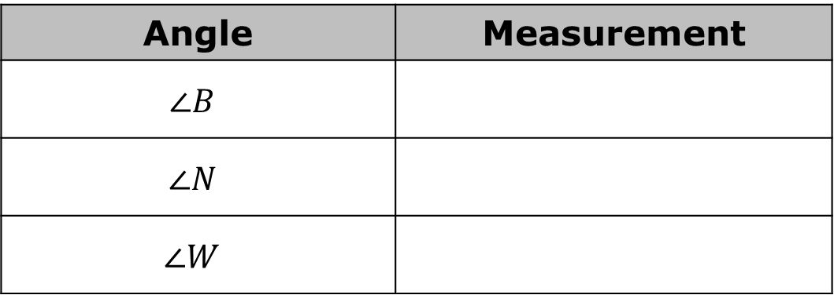
7.H2.5 Your Turn!
In $∆BNW, BN=9, NW=12,$and$BW=13$. Find the missing angles.
Angle | Measurement
$$∠B$$
$$∠N$$
$$∠W$$
volume 1, pg. 438

Slide 20
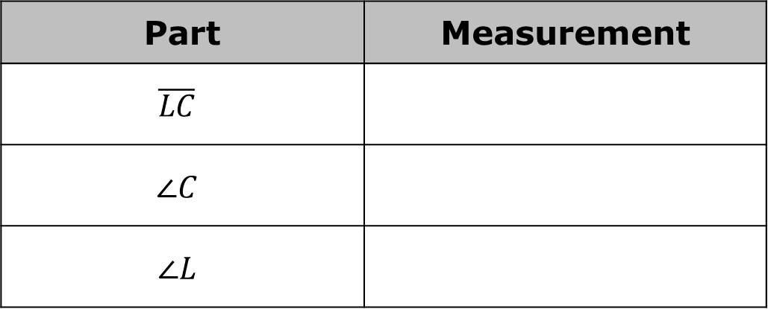
In $∆SLC, SC=34, SL=22$, and $m∠LSC=42°$. Find all missing sides and angles.
Part | Measurement
$$\overline{LC}$$
$$∠C$$
$$∠L$$
volume 1, pg. 438

Slide 21

Wrap-Up
volume 1, pg. 439

Slide 22
7.H2.6 Wrap-Up: Cool Down
Write a summary of what you learned today.
volume 1, pg. 439

